Slide 1
Putting It All Together: Optimizing Workflows
Christina Koch ckoch5@wisc.edu
Research Computing Facilitators
University of Wisconsin - Madison

Slide 2
Key HTC Tactics
Increase Overall Throughput
Utilize Resources Efficiently!
Bring Dependencies With You
Scale Gradually, Testing Generously
Automate As Many Steps As Possible
Make it easier to manage all your jobs

Slide 3
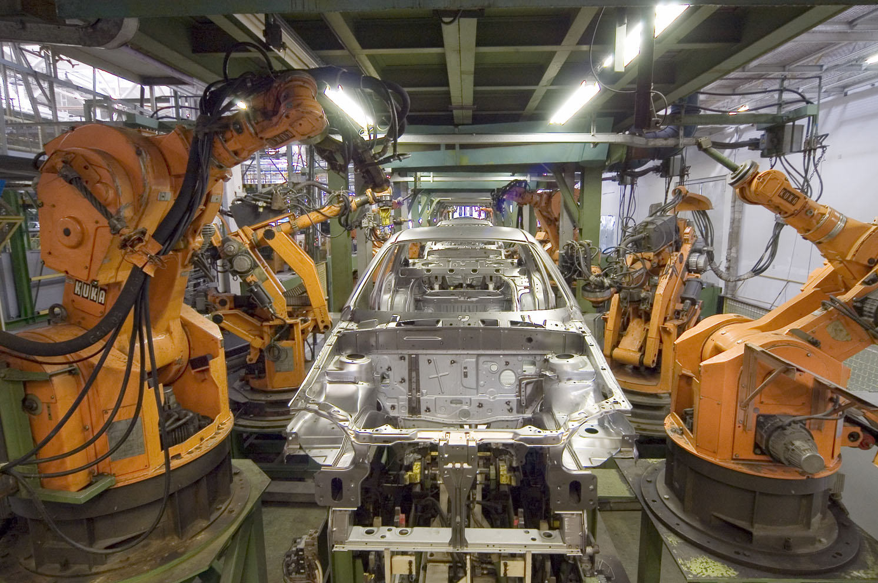
What to Automate?
Submitting many jobs (using HTCondor)
Writing submit files using scripts
Running a series of jobs, or workflow

Slide 4
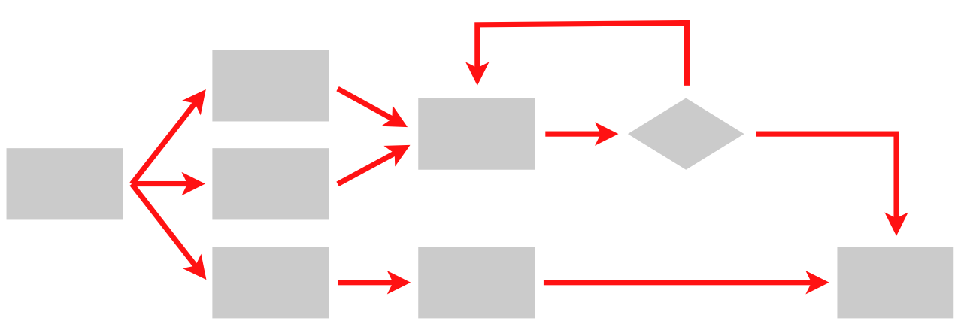
What is a Workflow?
A series of ordered steps
Steps
Connections
(Metadata)

Slide 5
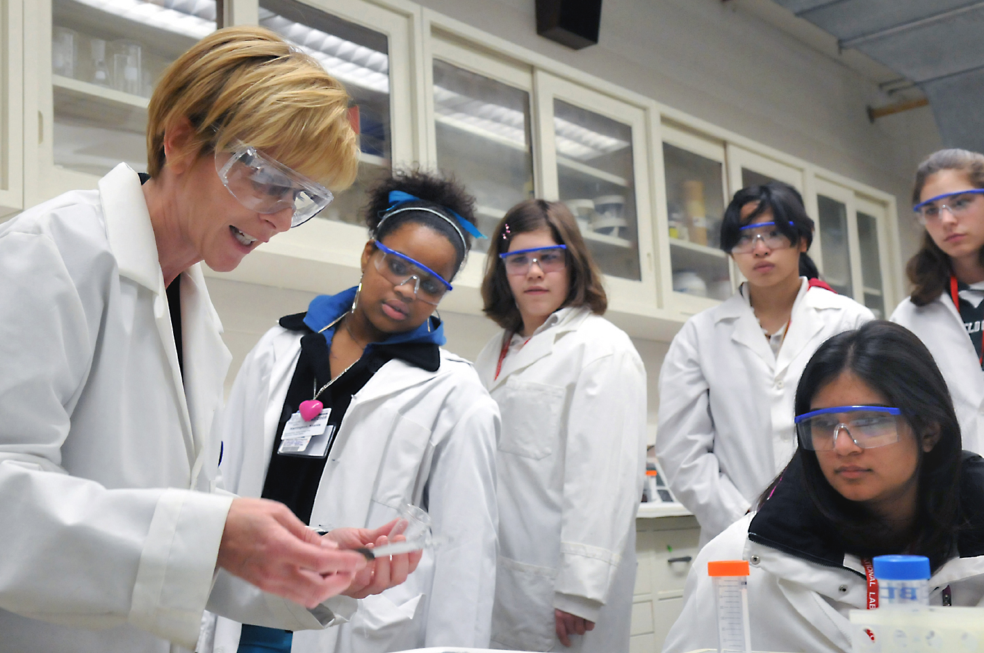
We Workflows
non-computing “workflows” are all around you, especially in science
instrument setup
experimental procedures and protocols
when planned/documented, workflows help with:
organizing and managing processes
saving time with automation
objectivity, reliability, and reproducibility
(THE TENETS OF GOOD SCIENCE!)

Slide 6
Getting the most out of workflows

Slide 7
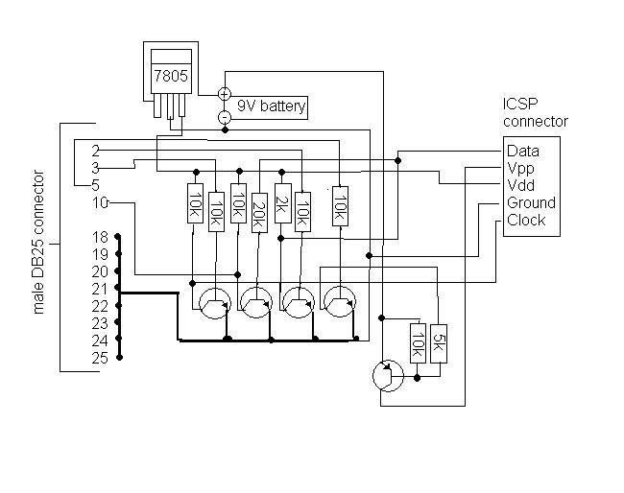
From schematics…

Slide 8
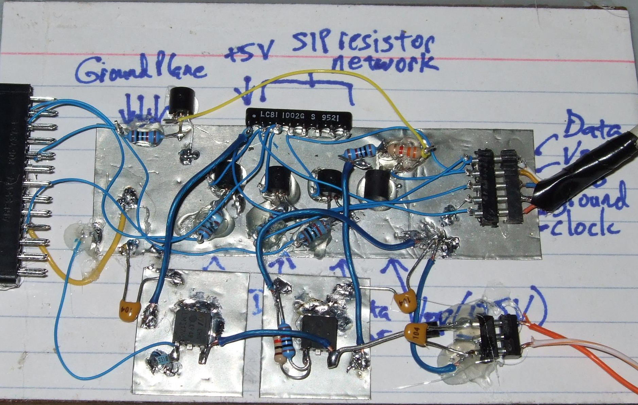
… to the real world

Slide 9
Optimizing a Workflow
Draw out the workflow, identify pieces
Modular development: test and optimize each piece
divide or consolidate ‘pieces’
determine resource requirements
identify steps to be automated or checked
Put the pieces together gradually
Bonus features
Error proofing
Additional automation

Slide 10
Workflow Drawing, v.1
data prep (minutes)
processing
(days)
assess results
(minutes)

Slide 11
Workflow Drawing, v.2 (w/ HTC)
data prep/split
. . .
process ‘0’
process ’99’
combine, assess results

Slide 12
Workflow Pieces
What are the main steps of the previous workflow?
Splitting the data - probably a script?
Jobs to process the data - need submit files, scripts, software, etc.
Combining the data - probably another script

Slide 13
Optimizing a Workflow
Draw out the workflow, identify pieces
Modular development: test and optimize *each piece*
divide or consolidate ‘pieces’
determine resource requirements
identify steps to be automated or checked
Put the pieces together gradually
Bonus features
Error proofing
Additional automation

Slide 14
To Get Here …
(special transfer)
file prep and split
(POST-RETRY)
1 GB RAM
2 GB Disk
1.5 hours
. . .
100 MB RAM
500 MB Disk
40 min
(each)
process ‘0’
(filter output)
process ‘99’
(filter output)
(POST-RETRY)
(POST-RETRY)
(PRE)
combine, transform results
(POST-RETRY)
300 MB RAM
1 GB Disk
15 min

Slide 15
Start Here
Start with one piece of the workflow and apply the testing/optimization ideas from the previous presentation (one job, small test, scale test)
. . .
process ‘0’
(filter output)
process ‘99’
(filter output)

Slide 16
Test Another Step
. . .
process ‘0’
(filter output)
process ‘99’
(filter output)
combine, assess results

Slide 17
And Another Step
prep conditions and/or split data
. . .
process ‘0’
(filter output)
process ‘99’
(filter output)
combine, assess results

Slide 18
End Up with This
(special transfer)
file prep and split
1 GB RAM
2 GB Disk
1.5 hours
. . .
100 MB RAM
500 MB Disk
40 min
(each)
process ‘0’
(filter output)
process ‘99’
(filter output)
combine, transform results
300 MB RAM
1 GB Disk
15 min
Notes:
Remove?

Slide 19
Optimizing a Workflow
Draw out the workflow, identify pieces
Modular development: test and optimize each piece
divide or consolidate ‘pieces’
determine resource requirements
identify steps to be automated or checked
Put the pieces together gradually
Bonus features
Error proofing
Additional automation

Slide 20
DAGs Automate Workflows
data prep/split
. . .
process ‘0’
process ’99’
combine, assess results

Slide 21
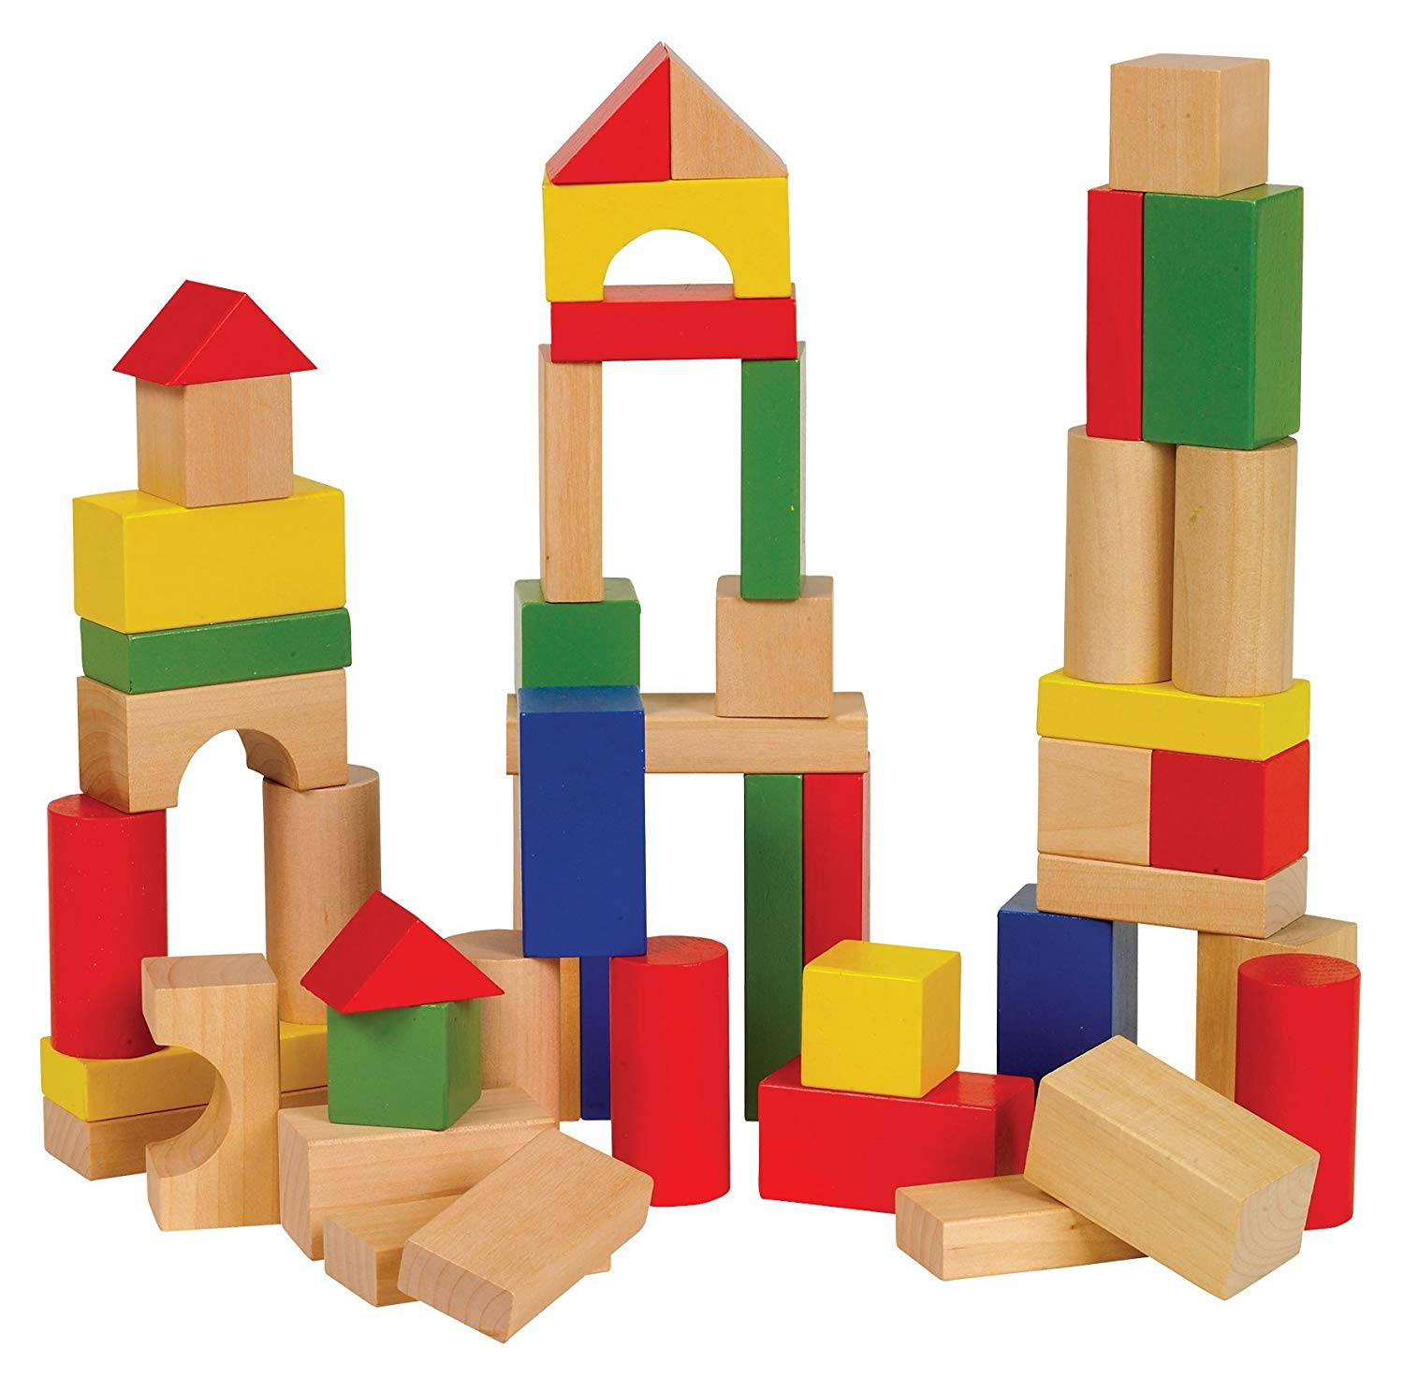

Scaling Workflows
Same principles as before -- run a test DAG, with a small amount of data/jobs, before running the full thing.

Slide 22
In Full Detail
(special transfer)
file prep and split
(POST-RETRY)
1 GB RAM
2 GB Disk
1.5 hours
. . .
100 MB RAM
500 MB Disk
40 min
(each)
process ‘0’
(filter output)
process ‘99’
(filter output)
(POST-RETRY)
(POST-RETRY)
(PRE)
combine, transform results
(POST-RETRY)
300 MB RAM
1 GB Disk
15 min

Slide 23
Solutions for Large Workflows
Use a DAG to throttle the number of idle or queued jobs (“max-idle” and/or “DAGMAN CONFIG”)
new HTCondor options to do this in a submit file as well
Add more resiliency measures
“RETRY” (works per-submit file)
“SCRIPT POST” (use $RETURN, check output)
Use SPLICE, VAR, and DIR for modularity/organization

Slide 24
Optimizing a Workflow
Draw out the workflow, identify pieces
Modular development: test and optimize each piece
divide or consolidate ‘pieces’
determine resource requirements
identify steps to be automated or checked
Put the pieces together gradually
Bonus features
Error proofing
Additional automation

Slide 25
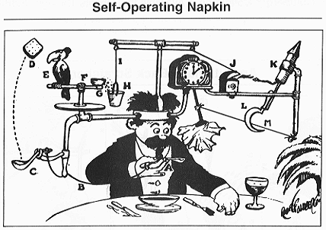
Robust Workflows
Your DAG runs at scale! Now what?
Need to make it run everywhere, everytime
Need to make it run unattended
Need to make it run when someone else tries

Slide 26
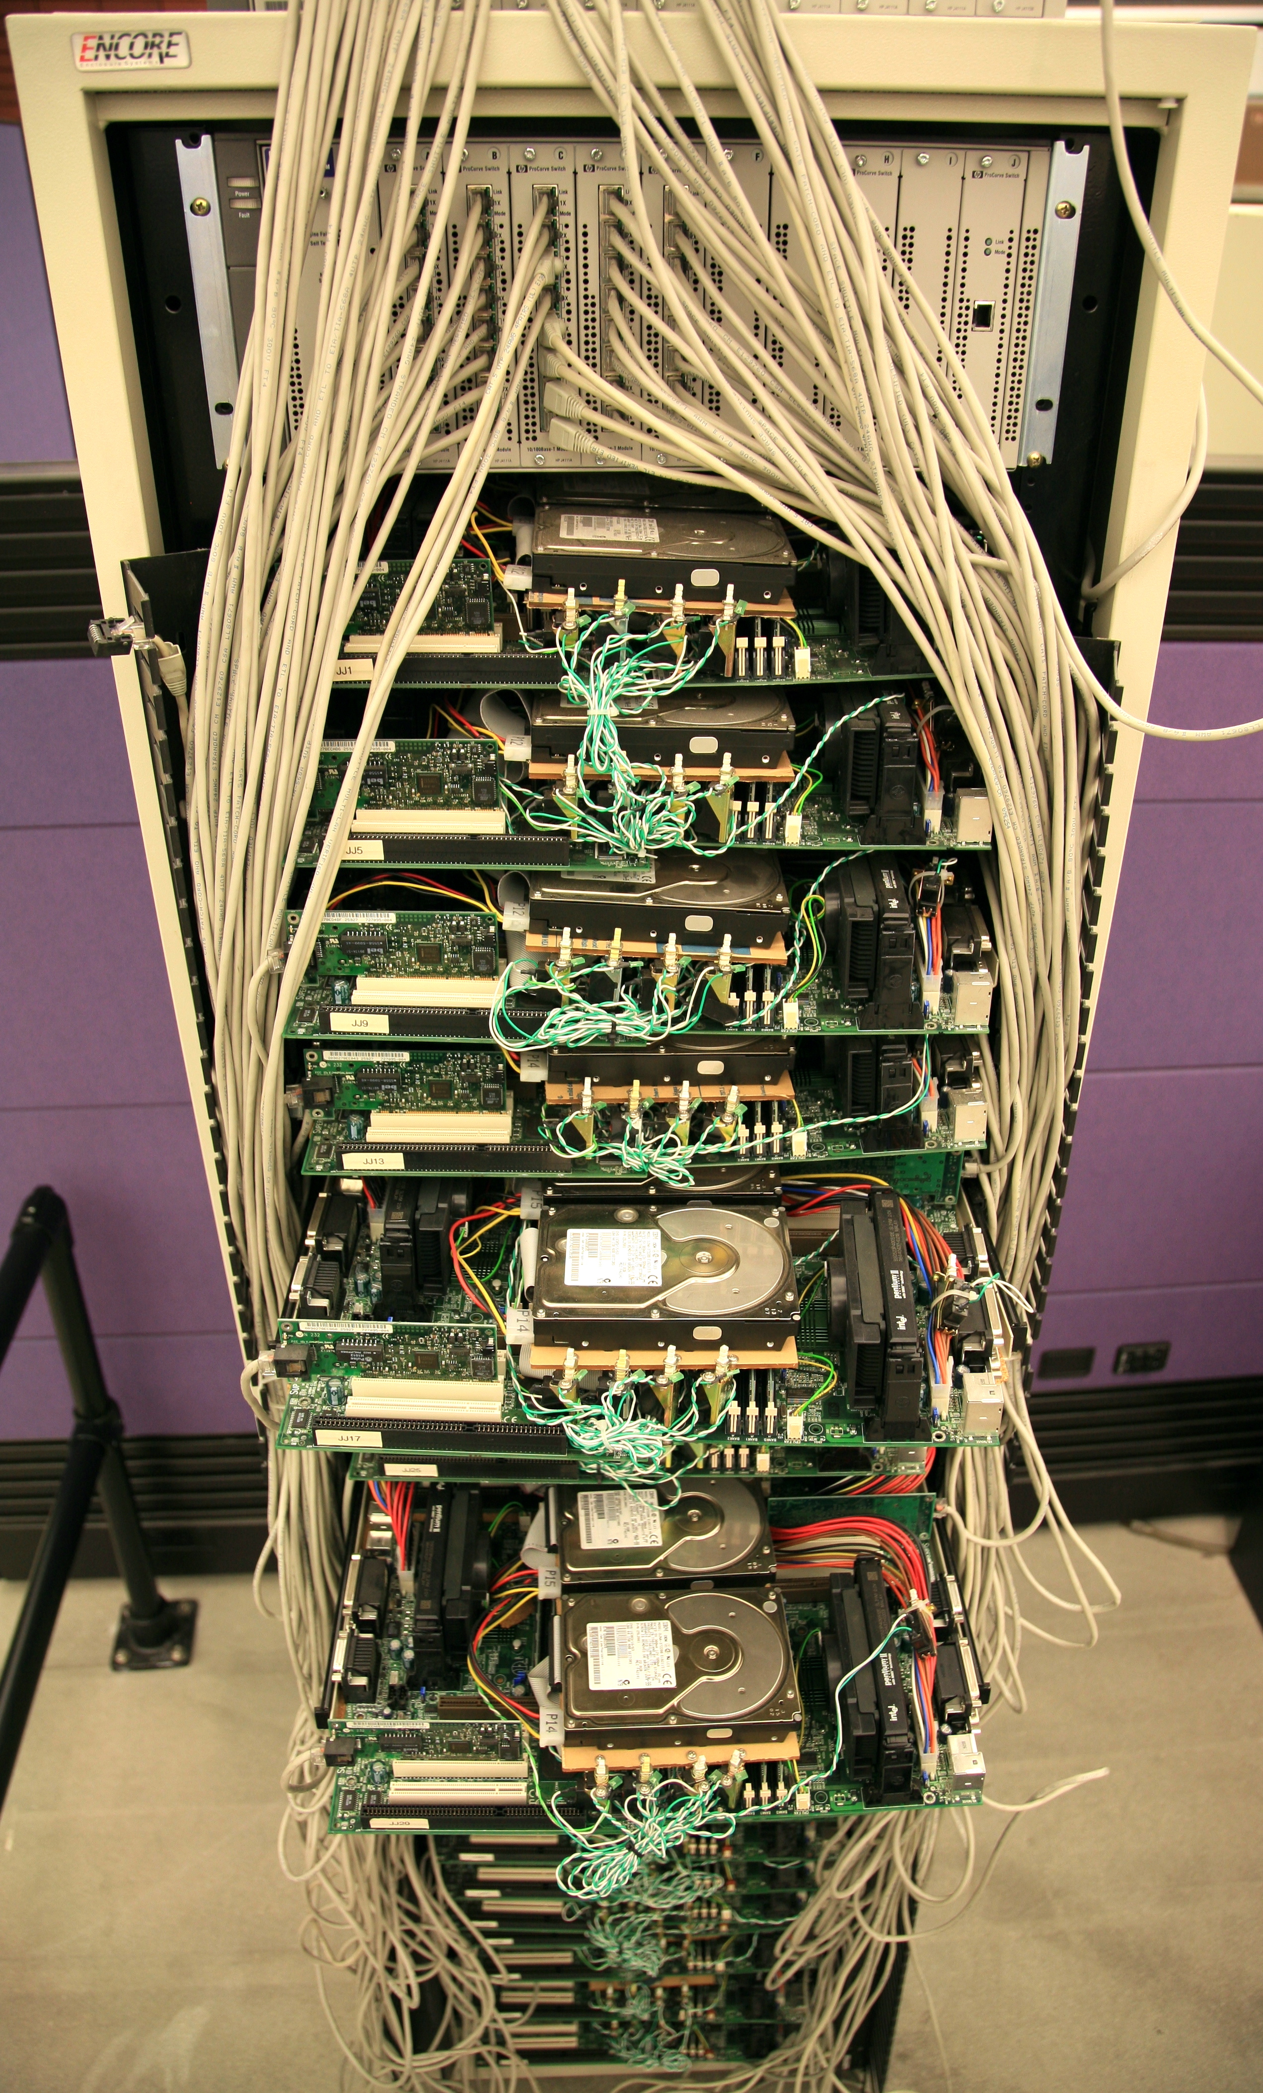
Make It Run Everywhere
What does an OSG machine have?
Prepare for very little
Bring as much as possible with you, including:
executable
likely, more of the “environment”

Slide 27

Make It Work Everytime
What could possibly go wrong?
Eviction
Non-existent
dependencies
File corruption
Performance surprises
Network
Disk
…
Maybe even a bug in your code

Slide 28
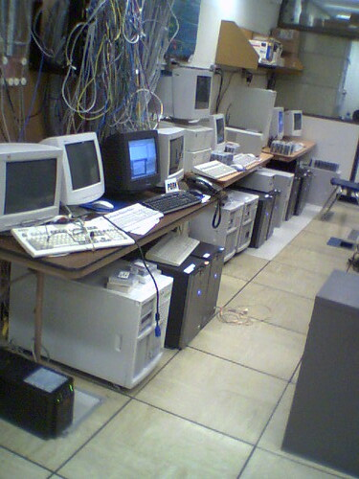
Performance Surprises
One bad node can ruin your whole day
“Black Hole” machines
Depending on the error, email OSG!
REALLY slow machines
use periodic_hold / periodic_release

Slide 29
Error Checks Are Essential
If you don’t check, it will happen…
Check expected file existence, and repeat with a finite loop or number of retries
better yet, check rough file size too
Advanced:
RETRY for specific error codes from wrapper
“periodic_release” for specific hold reasons

Slide 30
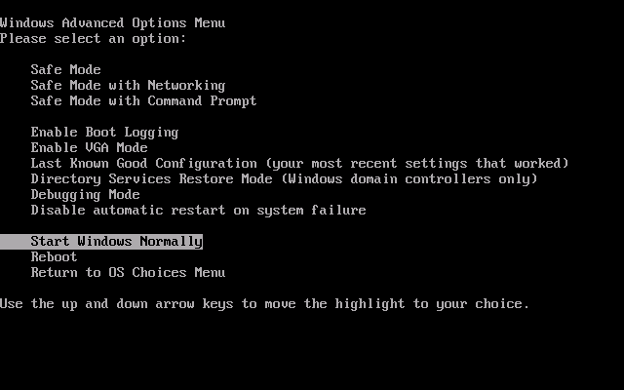
Handling Failures
Understand something about failure
Use DAG “RETRY”, when useful
Let the rescue dag continue…

Slide 31
Make It Run(-able) for Someone Else
Automation is a step towards making your research reproducible by someone else
Work hard to make this happen.
It’s their throughput, too.
Can benefit those who want to do similar work

Slide 32
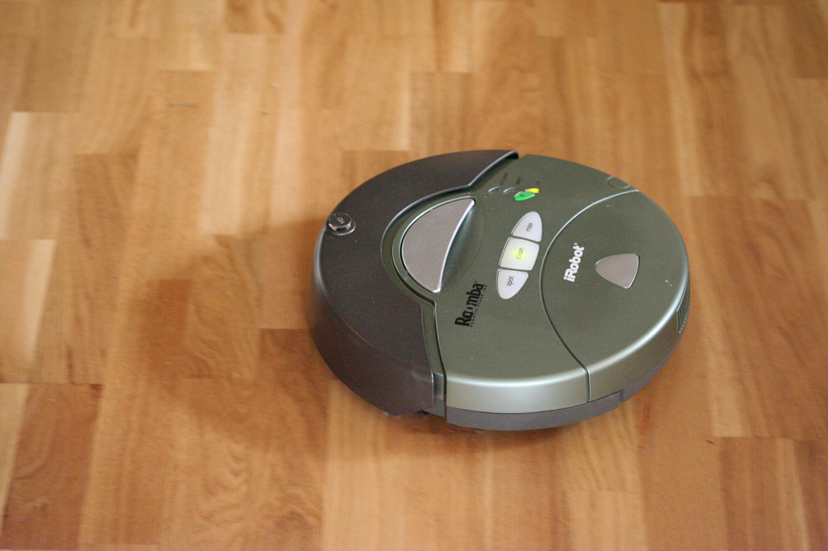
Make It Work Unattended
Remember the ultimate goal:
Automation! Time savings!
Potential things to automate:
Data collection
Data preparation and staging
Submission (condor cron)
Analysis and verification
LaTeX and paper submission ☺

Slide 33
parting thoughts

Slide 34
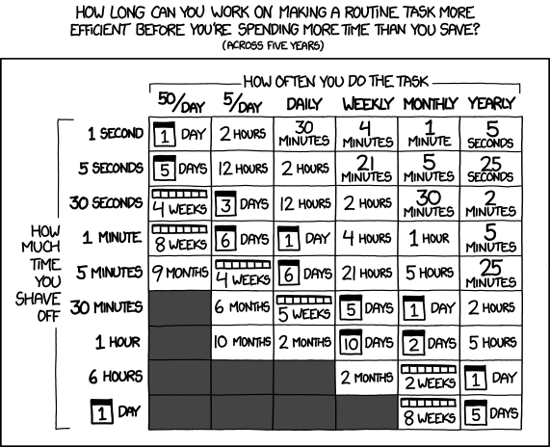
Automating workflows can save you time...
http://xkcd.com/1205/

Slide 35
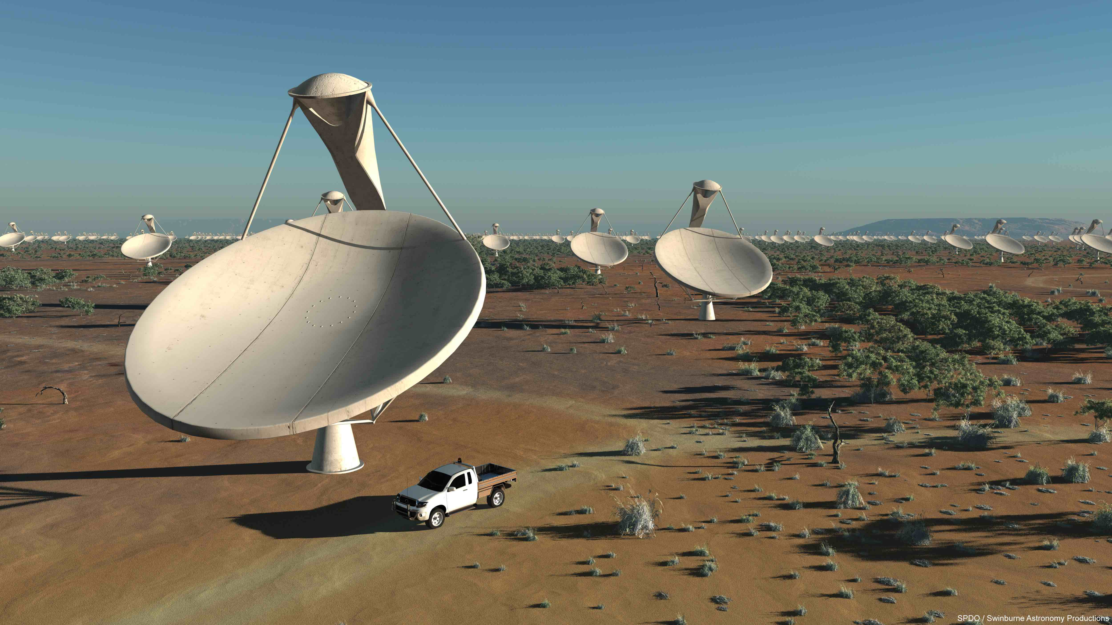
… but there are even more benefits of automating workflows
Reproducibility
Building knowledge and experience
New ability to imagine greater scale, functionality, possibilities, and better SCIENCE!!

Slide 36
Getting Research Done
End goal: getting the research done
Hopefully you now have the tools to get the most out of:
Computing: which approach and set of resources suit your problem?
High Throughput computing: optimize throughput, use portable data and software
Workflows: build, test and scale

Slide 37
Questions?
Now: Exercises 2.1 (2.2 Bonus)
Next:
Lunch
Discovery Tour + Group Photo
HTC Showcase!

